Slide 1

Slice Demand
Sprint 2
Samuel Ferrer

Slide 2

Problem Statement:
How can we reduce waste based on historical data of the restaurant to increase or maximize profits?

Slide 3
Proposed Solution & Impact
Proposal:
Using machine learning models, particularly time series models, restaurant owners can predict customer demand based on historical data.
Impact:
Restaurant owners can boost profits by understanding customer demand, which helps minimize waste from unconsumed or unused products.
Notes:
If restaurant owners would like to expand within the food and beverage realm within hospitality they can use this model to plan and ensure they can start making profits.

Slide 4
Preprocessed Data
Column Name | Description | Data Type
Date | Date associated to each column | datetime64
Sold (Qty) | Total slices sold | int64
Produced (Qty) | Total slices produced | int64
Waste (%) | Percentage of slices wasted | float64
Waste (Qty) | Total slices wasted | int64
Temperature (Avg.) | Average temperature of the day | float64
Revenue/ Profit | Total Profit of slices | int64 (previously object)
Pepperoni | Binary column to indicate flavor | int64
Cheese | Binary column to indicate flavor | int64
Napolitana | Binary column to indicate flavor | int64
Primavera | Binary column to indicate flavor | int64
Vegetariana | Binary column to indicate flavor | int64
Season | Time of year for Restaurants | int64
Rain? | Binary column showing whether it rained or not that day | int64

Slide 5
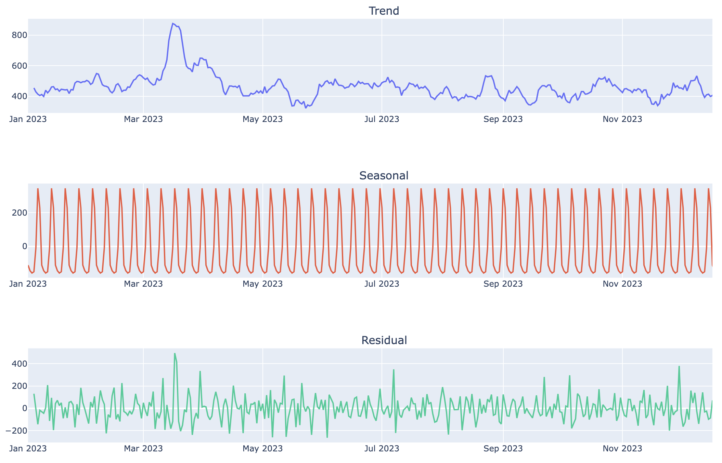
Exploratory Data Analysis (Cont.)
It doesn't seem like there is a clear trend on a day-to-day basis as shown by the inconsistent spikes throughout the trend visual.
When it comes to the Seasonal visualization, we can see a strong seasonal component which is supported by the repeating patterns.
The residuals show that there are some irregularities and noise that might need further investigation.

Slide 6
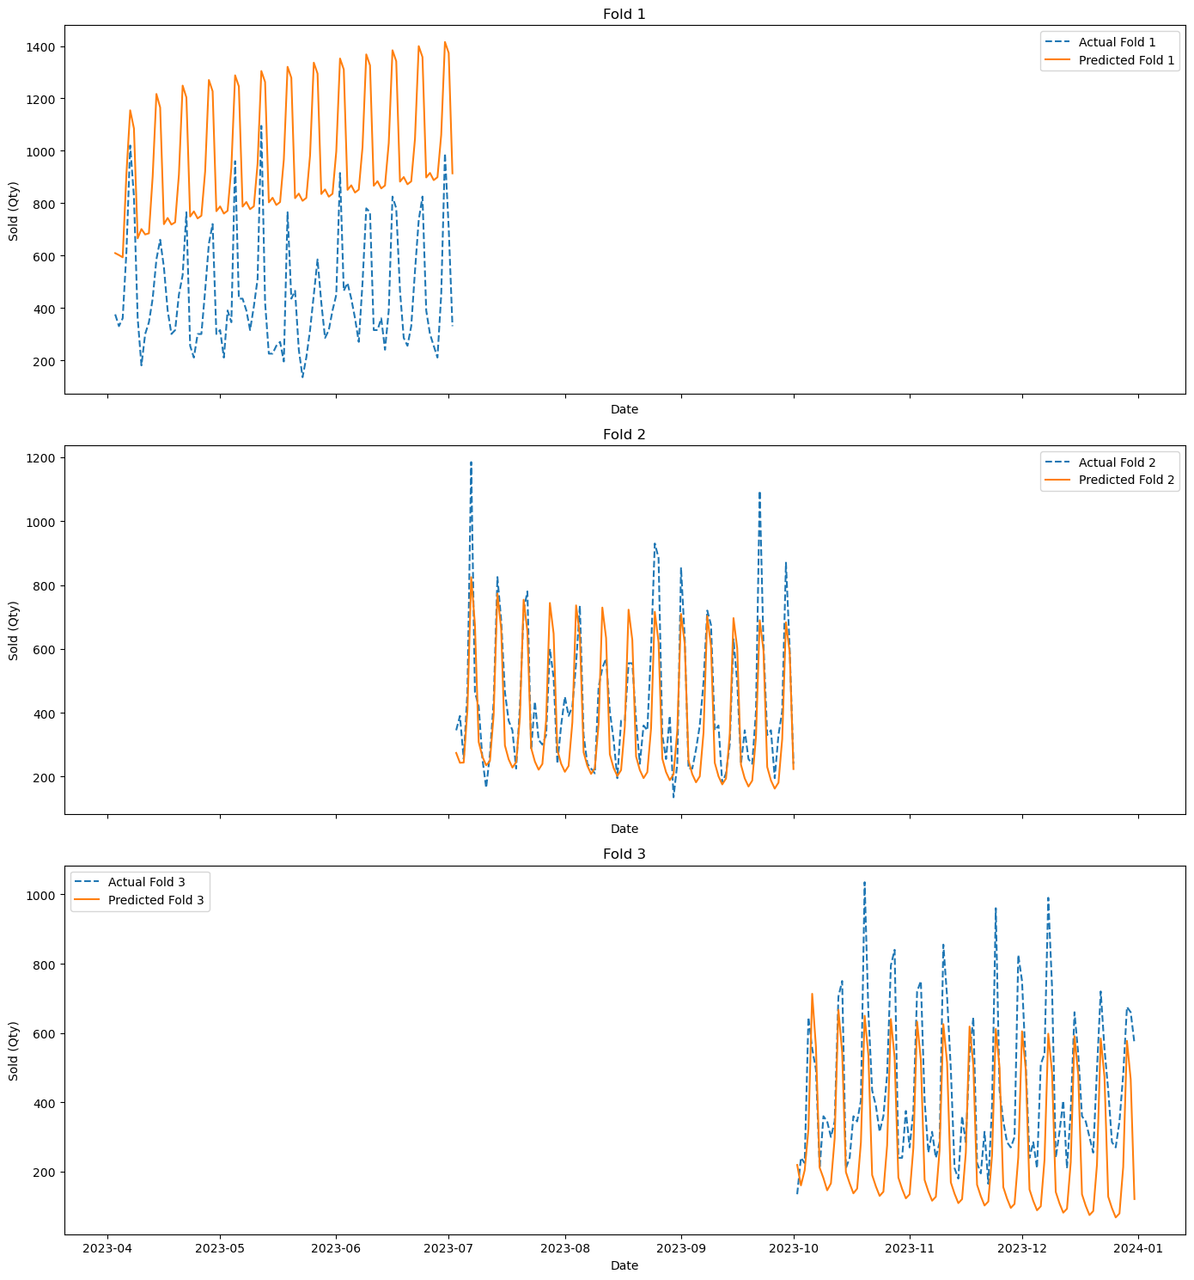
Baseline Model: SARIMAX
The SARIMAX model allows us to incorporate seasonal components in our data set.
Inputs:
Sold (Qty) column
Weekly seasonal period
Evaluation Scores:
Fold 1: MAE = 512.35, MSE = 285237.55
Fold 2: MAE = 97.21, MSE = 15567.33
Fold 3: MAE = 172.74, MSE = 41267.59

Slide 7
Next Steps
Explore more advanced models like Prophet and an LSTM neural network.
Brainstorm ideas for productizing the final model.

